Slide 1

Most Popular Components
By,
Naveenkumar Mahalingam
Software Engineer

Slide 2

Most Popular Components
DataGrid
Charts
List View
Scheduler
Diagram
PDF Viewer
Excel Library

Slide 3
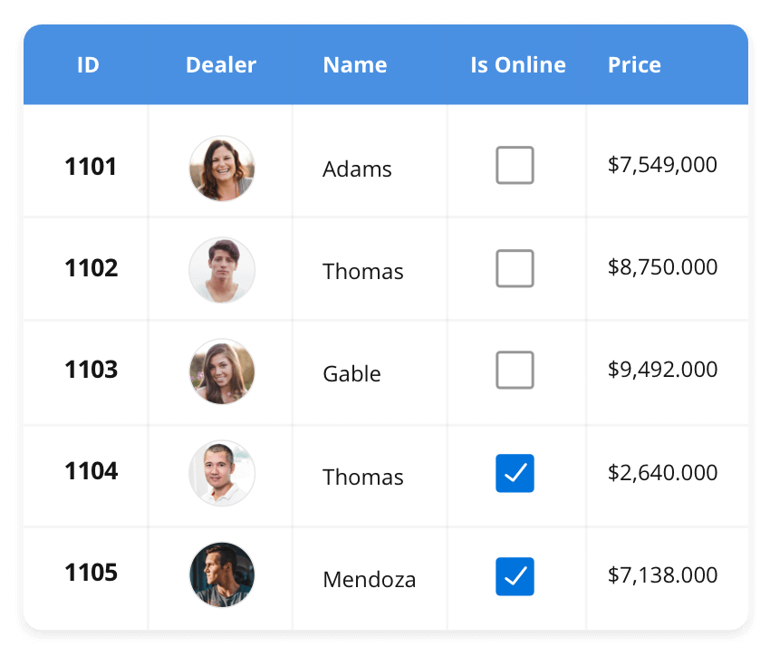



DataGrid
The DataGrid control is a high-performance grid component that helps display and manipulate large amounts of data in a tabular format. Its rich feature set includes functionalities like data binding, sorting, grouping, editing, filtering, swiping, dragging, resizing, loading more items, pull-to-refresh, and exporting to Excel and PDF file formats.
SUPPORTED PLATFORMS
JavaScript
Angular
React
Vue
Blazer
Flutter
jQuery
ASP.NET MVC
ASP.NET Core
ASP.NET WEB Forms
WinForms
WPF
Win UI
Flutter
Xamarin
UWP
Xamarin
Flutter
UWP

Slide 4
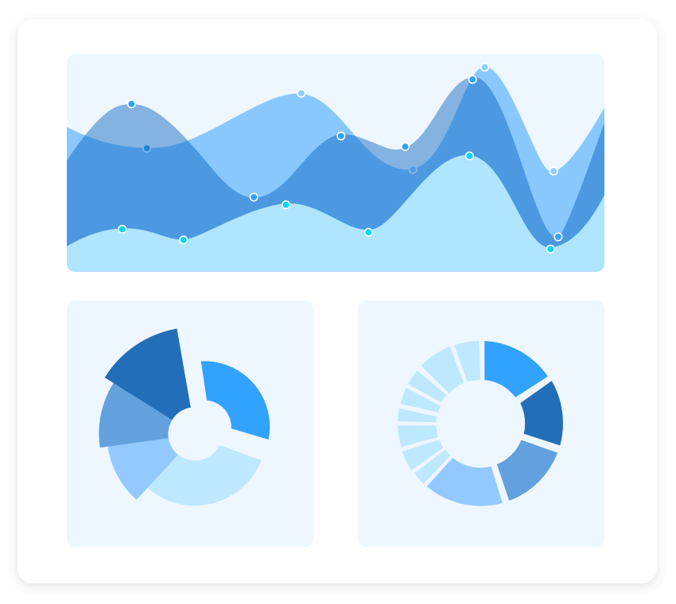
Charts
The Charts control can plot a wide range of chart types, ranging from line charts to specialized financial charts. Its rich feature set includes functionalities like data binding, multiple axes, legends, animation, data labels, annotations, trackballs, tooltips, and zooming.
SUPPORTED PLATFORMS
JavaScript
Angular
React
Vue
Blazer
Flutter
jQuery
ASP.NET MVC
ASP.NET Core
ASP.NET WEB Forms
WinForms
WPF
Win UI
Flutter
Xamarin
UWP
.NET MAUI
Xamarin
Flutter
UWP
JavaScript
.NET MAUI

Slide 5
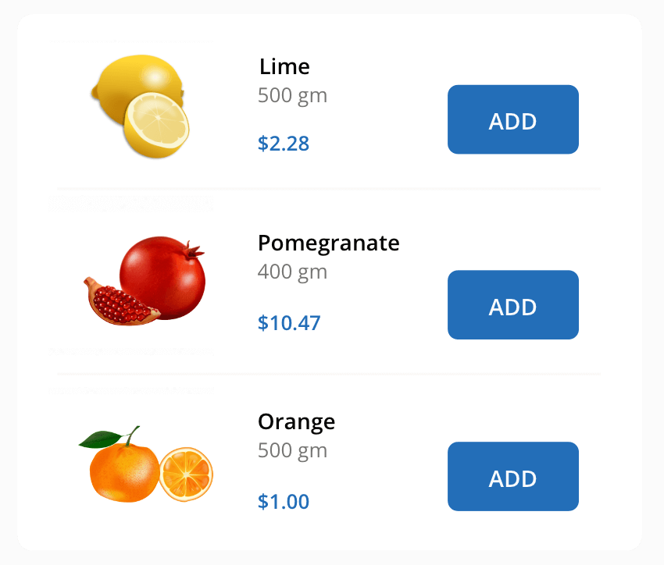
ListView
The ListView renders a set of data items with UI views or custom templates. It has many features like grouping, sorting, filtering, paging, swiping, multiple selection, drag and drop, and different layout types. The ListView control has been optimized to work with large amounts of data.
SUPPORTED PLATFORMS
JavaScript
Angular
React
Vue
Blazer
jQuery
ASP.NET MVC
ASP.NET Core
ASP.NET WEB Forms
WinForms
.NET MAUI
Xamarin
.NET MAUI
Xamarin
JavaScript

